Slide 1

The Garrod Association
The Canadian Association of Centres for the Management of Hereditary Metabolic Diseases
ANNUAL GENERAL MEETING
2025 Annual General Meeting
Saturday, May 10, 2025
University of British Columbia, Great Hall North
12:05pm

Slide 2
The Garrod Association
The Canadian Association of Centres for the Management of Hereditary Metabolic Diseases
ANNUAL GENERAL MEETING AGENDA
Motion to accept the agenda
Motion to accept the 2024 meeting minutes
President’s Report – Aziz Mhanni
Finance Report – Nathalie Lepage
Auditors
Liaison and Relationships Committee Report – Cheryl Greenberg
Guidelines Committee Report – Andrea Yu
Award Program Report – Aziz Mhanni
Royal College Subspecialty Training Working Group Report – Sandra Sirrs
Varia
Conclusion

Slide 3

The Garrod Association
The Canadian Association of Centres for the Management of Hereditary Metabolic Diseases
1. MOTION TO ACCEPT THE AGENDA

Slide 4
The Garrod Association
The Canadian Association of Centres for the Management of Hereditary Metabolic Diseases
2. MOTION TO ACCEPT THE 2024 MEETING MINUTES

Slide 5
The Garrod Association
The Canadian Association of Centres for the Management of Hereditary Metabolic Diseases
3. PRESIDENT’S REPORT
Dr. Aziz Mhanni

Slide 6
The Garrod Association
The Canadian Association of Centres for the Management of Hereditary Metabolic Diseases
4. FINANCE REPORT
Dr. Nathalie Lepage

Slide 7
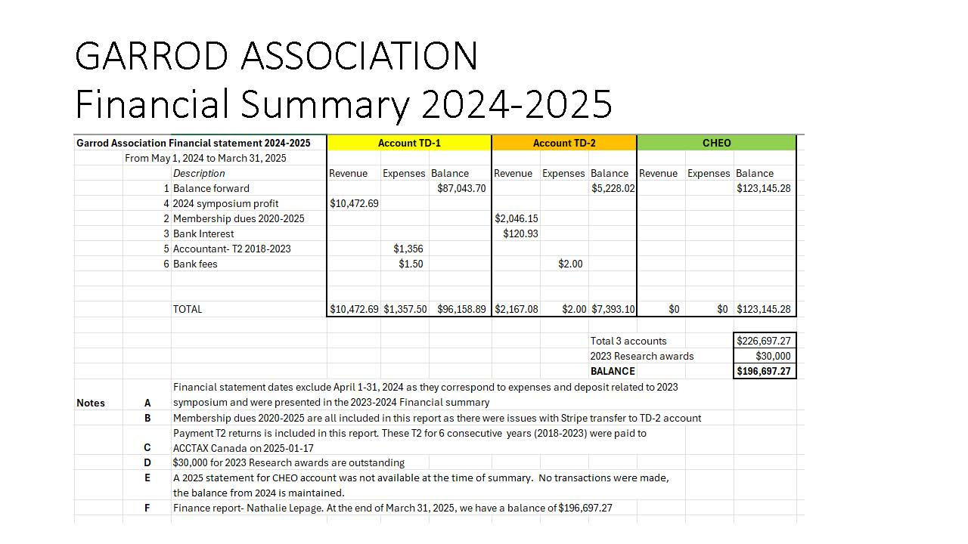

Slide 8
The Garrod Association
The Canadian Association of Centres for the Management of Hereditary Metabolic Diseases
5. Auditors
Dr. Nathalie Lepage
Auditors
Lauren MacNeil, PhD, FCCMG Biochemical Geneticist Alberta Precision Laboratories | Pierre Allard, PhD, FCCMG Biochimiste Clinique Sainte-Justine Hospital

Slide 9
The Garrod Association
The Canadian Association of Centres for the Management of Hereditary Metabolic Diseases
6. Liaison and Relationships Committee Report
Dr. Cheryl Greenberg

Slide 10
The Garrod Association
The Canadian Association of Centres for the Management of Hereditary Metabolic Diseases
6. Liaison and Relationships Committee Report
Committee Members
Dr. Saadet Andrews
Dr. Sarah Dyack
Dr. John Mitchell
Dr. Cheryl Rockman-Greenberg (Chair)
Dr. Andreas Schulze
Dr. Sandra Sirrs

Slide 11
The Garrod Association
The Canadian Association of Centres for the Management of Hereditary Metabolic Diseases
7. Guidelines Committee Report
Dr. Andrea Yu

Slide 12
The Garrod Association
The Canadian Association of Centres for the Management of Hereditary Metabolic Diseases
7. Guidelines Committee Report
Committee Members
Daniela Buhas, MD – McGill
Pranesh Chakraborty, MD – CHEO
Sarah Dyack, MD – IWK Health Centre
Michal Inbar Feigenberg, MD – Sickkids
Shaily Jain, MD – Edmonton
Graeme Nimmo, MD – UHN
Murray Potter, MD – Hamilton
Beth Potter, PhD – Ottawa
Ingrid Tein, MD – Sickkids
Andrea C Yu, MD – CHEO (Chair)

Slide 13
The Garrod Association
The Canadian Association of Centres for the Management of Hereditary Metabolic Diseases
7. Guidelines Committee Report
Activity Updates
Improving Communications
  Feedback from previous Garrod AGM – previous website layout/lack of website barrier to dissemination of the work done by committee
  Suggestions for improving new Garrod website
    Different format for presentation of endorsed guidelines
    Feedback/comments/discussion mechanism on site for members regarding work
  Explore further collaboration with CCMG for publication (trainees more likely to consult CCMG website than Garrod)

Slide 14
The Garrod Association
The Canadian Association of Centres for the Management of Hereditary Metabolic Diseases
7. Guidelines Committee Report
Activity Updates
ER Letters Template Project
  Letters received from 9 centres across Canada
  Information is being tabulated by research coordinator (from Kingston) in preparation for review by Garrod Guidelines Committee
  Next step: discussion of individual items by the committee

Slide 15
The Garrod Association
The Canadian Association of Centres for the Management of Hereditary Metabolic Diseases
7. Guidelines Committee Report
Activity Updates
Industry Grants to support Guideline Development
  Guidelines are very resource intensive to create – need for Canadian specific guidelines
  Industry are willing to provide grants/sponsorship for creation of guidelines
  Need for the Garrod Association to minimize conflicts of interest
  Working on policy/framework so that the Garrod can be better set up to create guidelines going forward

Slide 16
The Garrod Association
The Canadian Association of Centres for the Management of Hereditary Metabolic Diseases
8. Award Program Report
Dr. Aziz Mhanni

Slide 17
The Garrod Association
The Canadian Association of Centres for the Management of Hereditary Metabolic Diseases
8. Award Program Report
Committee Members
Dr. Sarah Dyack
Dr. Anna Lehman
Dr. Aziz Mhanni
Dr. Grant Mitchell
Dr. Tony Rupar
Dr. Neal Sondheimer

Slide 18
The Garrod Association
The Canadian Association of Centres for the Management of Hereditary Metabolic Diseases
9. Royal College Subspecialty Training Working Group Report
Dr. Hanna Faghfoury
Dr. Sandra Sirrs

Slide 19
Update on Royal College Inherited Metabolic Disease Medicine Subspecialty Program
Garrod AGM
May 10, 2025

Slide 20
Rationale for Royal College accreditation of Inherited Metabolic Disease Medicine
Increasing visibility to other routes of entry (pediatrics, internal medicine, neurology)
Almost half of metabolic clinicians in Canada are >50y
<25 trainees in last 15 years trained in CCMG Clinical biochemical genetics have stayed in Canada to practice
Specialty Designation of Inherited Metabolic Medicine by RC impacts Physician Reimbursement
Ensure competencies are in line with needs of both pediatric and adult inherited metabolic medicine
Eligibility for Postgraduate Funding/Support
Notes:
Current training programs arenot training sufficient numbers to replace those who will retire, unless geneticists want to throw their hat in the ring

Slide 21
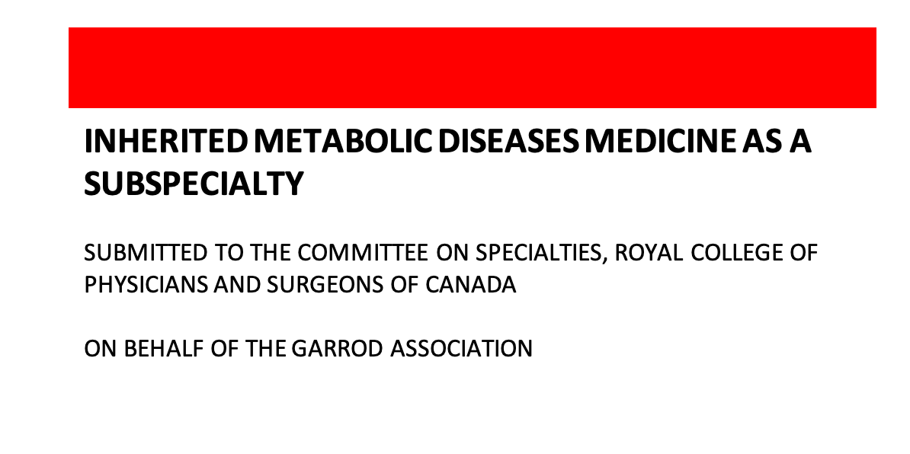

Slide 22
Multiple entry points, 2 different RC programs
Medical Genetics
Medical Genetics
1 year
1 year
Int Med
Pediatrics
Pediatric IMD Medicine
Adult IMD Medicine
Adult Neurology
Pediatric Neurology
2 years
2 years
Medical Biochemistry
Medical Biochemistry

Slide 23

In 2 short years….
May 2022
Proposal discussed at
Garrod AGM
June 2024
New Specialty approved
Meet with specialty committees:
Medical Genetics and Genomics
Internal Medicine, Pediatrics
Neurology, Medical Biochemistry,
Endocrinology and Metabolism
Draft proposal
Submitted to specialty
Committees for input
2021 Garrod
Workforce assessment
Identifies need to train
replacements
Nov 2023
COS greenlight
Phase 2
March 2022
Working group of Garrod
members meets to discuss
feasibility of preparing
RC proposal
First meeting with
CCMG to discuss
RC proposal
Meet with CCMG Board
August 2023
Proposal submitted
To COS

Slide 24
RC IMD MED working group
Dr. Hanna Faghfoury (Chair)
Dr. Sandra Sirrs (Vice Chair)
Dr. Danielle Bourque (Region 3)
Dr. Shailly Jain (Region 1)
Dr. Hugh McMillan (Region 3)
Dr. Trudy Nasmith (Region 1)
Dr. Marisa Chard (Region 4)
Dr. John Mitchell (Region 5)
Required Representation:
Specialty: Medical genetics, IMD, Adult medicine, Pediatric medicine, Neurology, Endocrinology
Regions: All 5 national regions
Royal College/Education expertise

Slide 25
Work that CCMG PDs/Garrod membership can do nationally in parallel
Currently:
RC Working group complete
First meeting with CCMG PDs
Fall 2025:
2nd Royal College Workshop- EPA development, follow up on objectives
June 2026:
All documents finalized by the Royal College, sent to translation
July 2027:
Absolute earliest programs could be established in Universities
.
12-18 months
June 2025:
1st Royal College Workshops: Intro to establishing new discipline, objectives of training
Spring 2026:
3rd Royal College Workshop- Drafting of required training experiences (mandatory, preferred, elective) and finalizing documents
Fall 2026:
Documents can be sent to PGME offices
July 2028+: Earliest start of subspecialty PGY1s

Slide 26
Work that CCMG PDs/Garrod membership can do nationally in parallel
Engage Postgraduate Deans
Reintroduce the IMD subspecialty and explore accreditation pathways and support.
Secure Fellow Funding
Understand local funding mechanisms and start advocating for IMD inclusion.
Collaborate on Common Program Elements nationally
Share tools/policies (e.g., fatigue risk, mentorship, evaluation) to reduce duplication.
Revamp Residency Training Committees (RTCs)
Involve allied specialties to support rotation planning and accreditation readiness.
Develop a National Academic Half-Day (AHD) Program
Coordinate cross-site teaching to reduce burden and enhance training quality.

Slide 27

How can I get involved?

Slide 28
The Garrod Association
The Canadian Association of Centres for the Management of Hereditary Metabolic Diseases
10. Varia

Slide 29
The Garrod Association
The Canadian Association of Centres for the Management of Hereditary Metabolic Diseases
11. Conclusion

Slide 30
The Garrod Association
The Canadian Association of Centres for the Management of Hereditary Metabolic Diseases
Thank you for attending!

